Slide 1
GD/GA Short Course
Overview

Slide 2
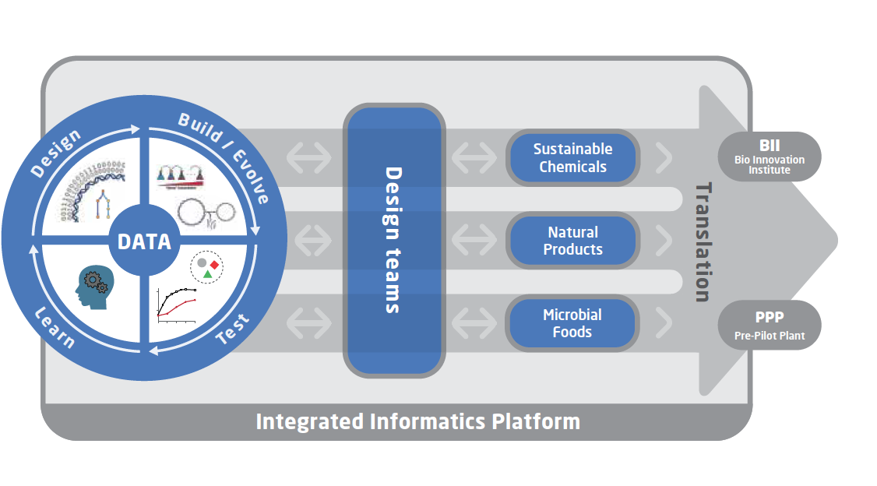
Genome Design and Analytics
Building computational tools to accelerate the strain design process
Short course is designed to enable CFB strain designers to utilize the tools we develop

Slide 3
Goals of the short course
Increase familiarity with concepts underlying each tool
e.g. What assumptions go into constraint-based models? When should they be applied?
Understand the utility of these tools
i.e. What predictions can they make? How can they help understand data?
Introduce hands-on experience so that these tools feel comfortable if the user wants to use them in their own work
Including software installation and helpful packages

Slide 4
Structure of these sessions
Part 1: Data analysis
Lecture 1 (1 hour)
Exercise 1 (1 hour)
Part 2: Prediction
Lecture 2 (1 hour)
Exercise 2 (1 hour)
Lectures and exercises available by cloning the repository here: https://github.com/SBRG/GDGA_Shortcourse
“Homework” sent out before each session with software installation instructions for this week’s tools
Try to follow along during the exercises on your own computer

Slide 5
Module 1: Constraint-based Reconstruction and Analysis (COBRA)
Part 1: Metabolic network reconstructions
and use in data analysis

Slide 6
Topics
What is a metabolic network reconstruction?
96 step protocol for metabolic reconstructions
Using gene annotations to define Gene-Protein-Reaction associations (GPRs)
Reaction mass/elemental balancing
Determining reaction thermodynamic reversibility
Modeling cell growth: The biomass reaction
Building tissue-specific reconstructions
Reconstruction tools

Slide 7
A brief history of metabolic network reconstructions

Slide 8
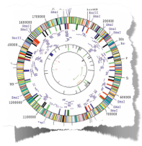

1995: birth of the genome era
Craig Venter
Whole genome sequences become available
“All” genetic elements in a genome can be identified and characterized
in principle but in practice 2/3
Genome-scale science enabled
Notes:
Very important milestone — scaling up
Biology becomes ‘industrial’, and very technology driven
Genome-scale science came into existence

Slide 9


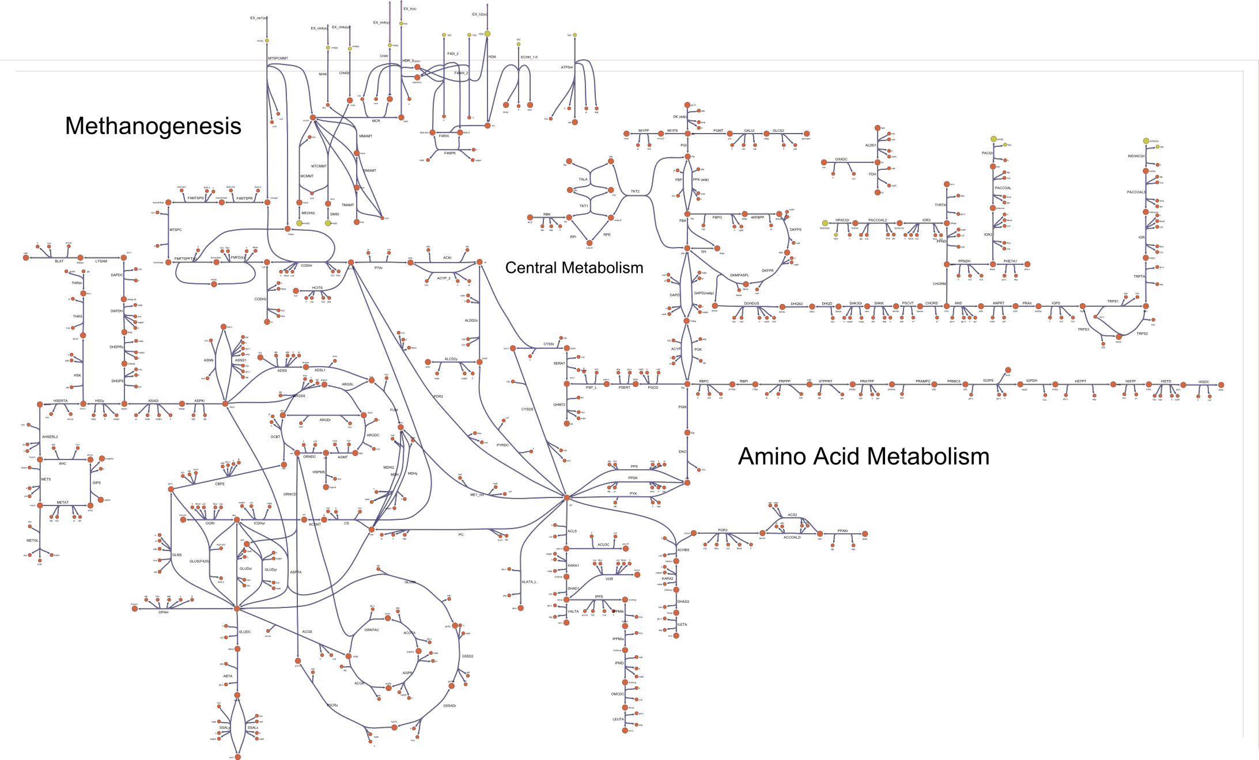
Putting the Pieces Together: Genome-scale Network Reconstructions, 1997-2000
Christophe Schilling
Jeremy Edwards
Organism-specific genome-scale metabolic networks
E. coli, H. influenzae, H. pylori
The first high-throughput in silico biologists
Notes:
All gene products function in the context of all other gene products
important thus to take a genome-scale point of view and contextualize all the gene products
the result is a network of chemical interactions
They effectively define a system
Although it looks the same, this map is different from what you see in a text book in that each biochemical event is tied to a gene product that in turn is tied to a gene and its genomic location

Slide 10
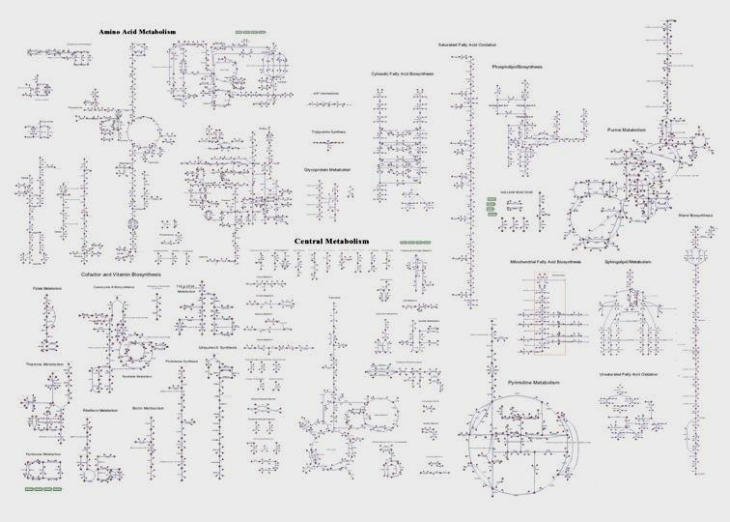



Extended to Eukaryotes (2001-03)
Jens Nielsen
Iman Famili
Baker’s Yeast,
Saccharomyces cerevisae
Jochen Fōrster

Slide 11
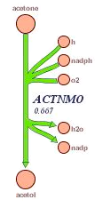
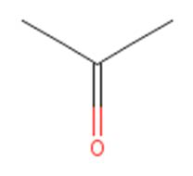
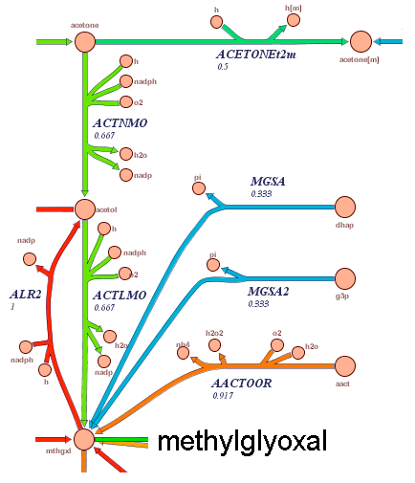
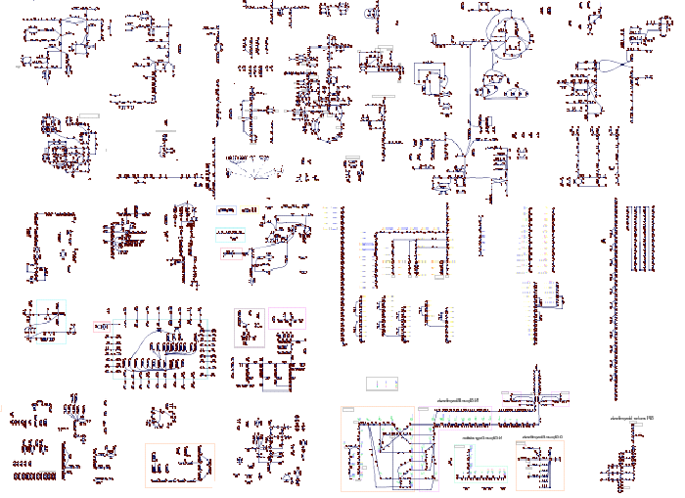
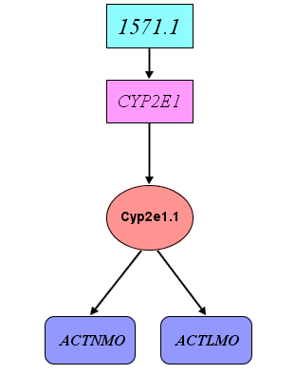
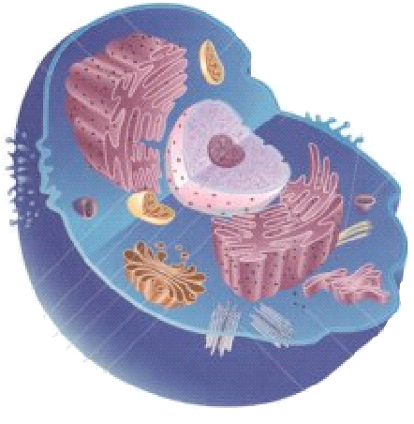

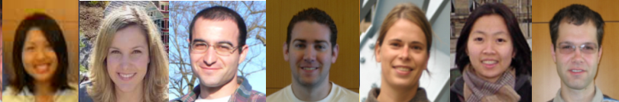
Human metabolism: RECON 1 (2005-07)
Global Metabolic Map
Comprehensively represents known reactions in human cells
Compounds (2,712)
Reactions (3,311)
Pathways (98)
Genes (1,496)
Transcripts (1,905)
Proteins (2,004)
Compartments (7)

Slide 12
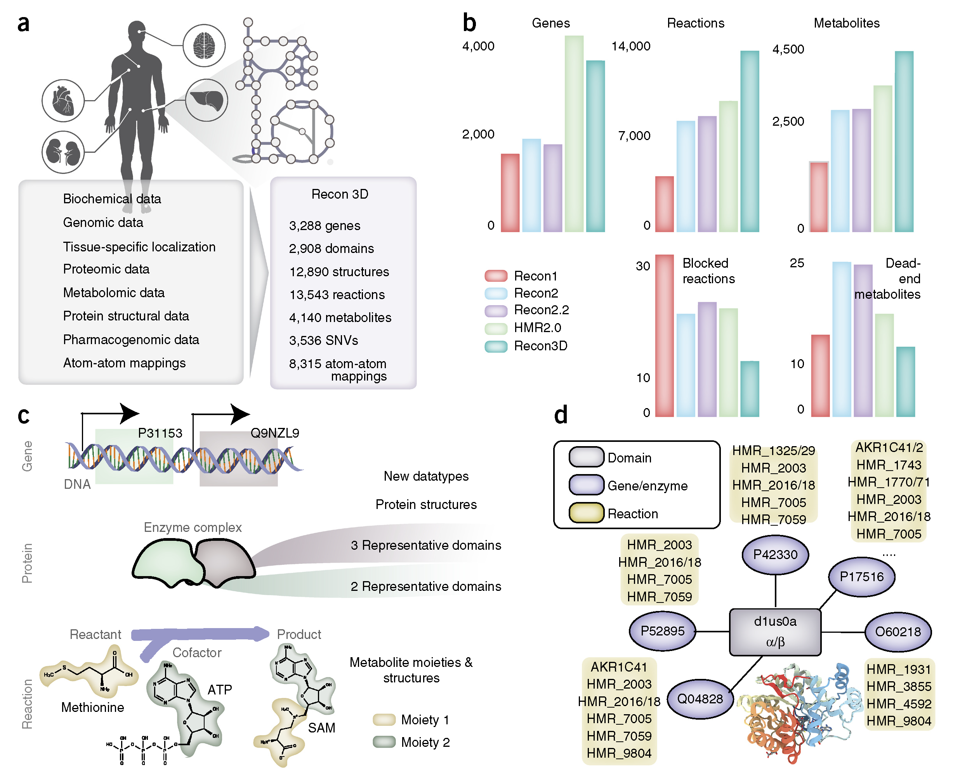
Recon 3D (2018)

Slide 13
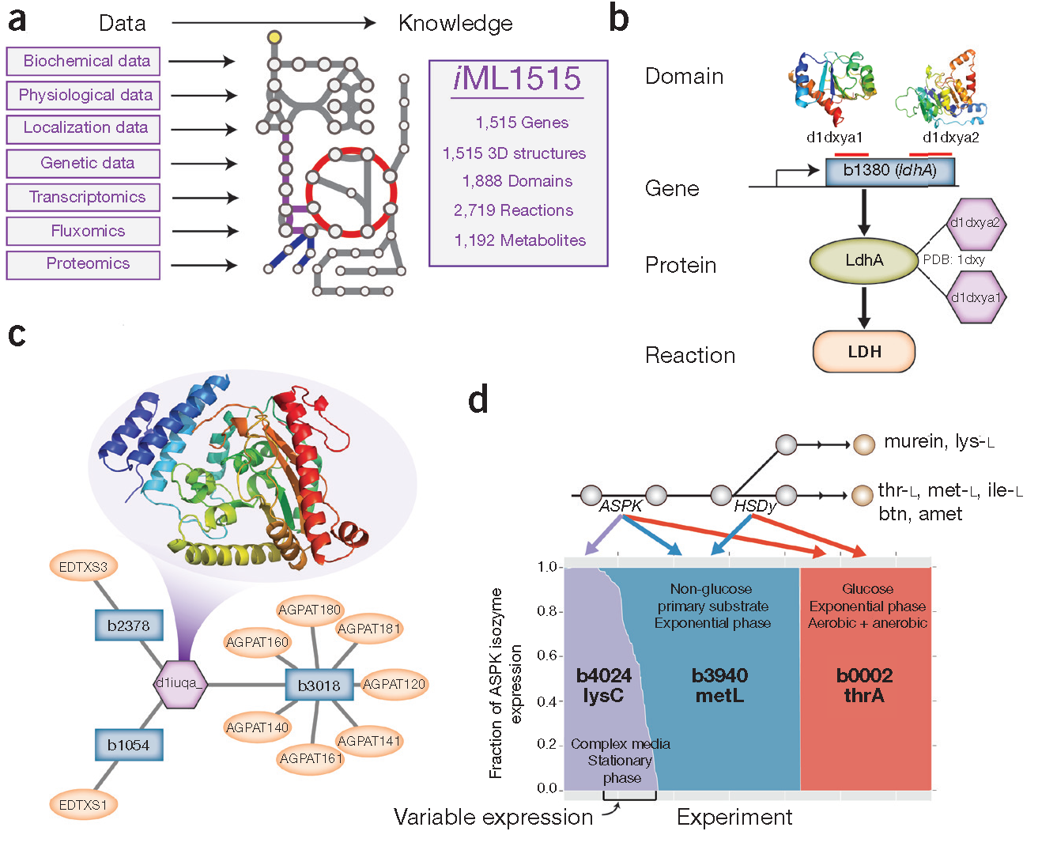
iML1515
(2017)

Slide 14
What goes into a metabolic network reconstruction?
How can we organize curated data into a knowledgebase?

Slide 15
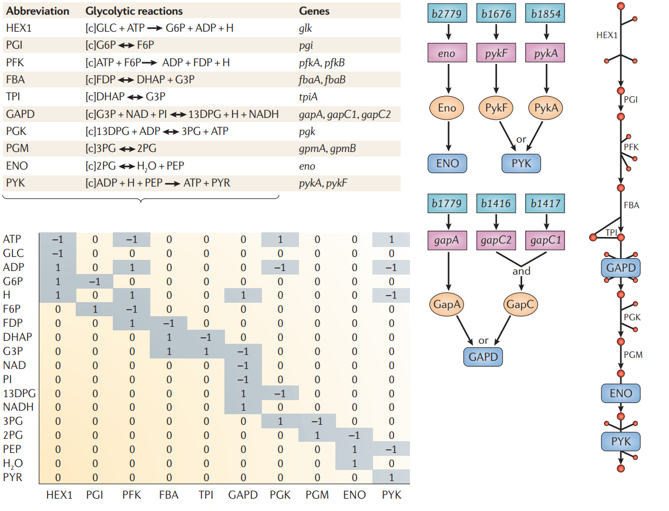
What is a metabolic network reconstruction?
Nature Reviews Genetics 7, 130–141 (2006)

Slide 16
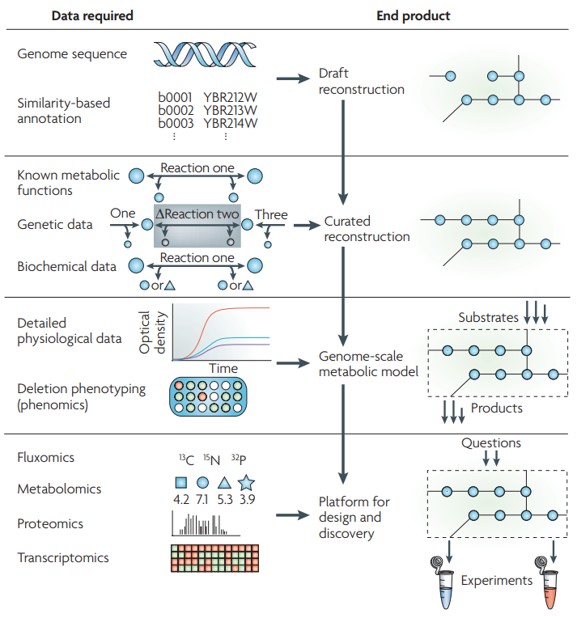
Reconstruction &
Model building
https://www.nature.com/articles/nrmicro1949

Slide 17
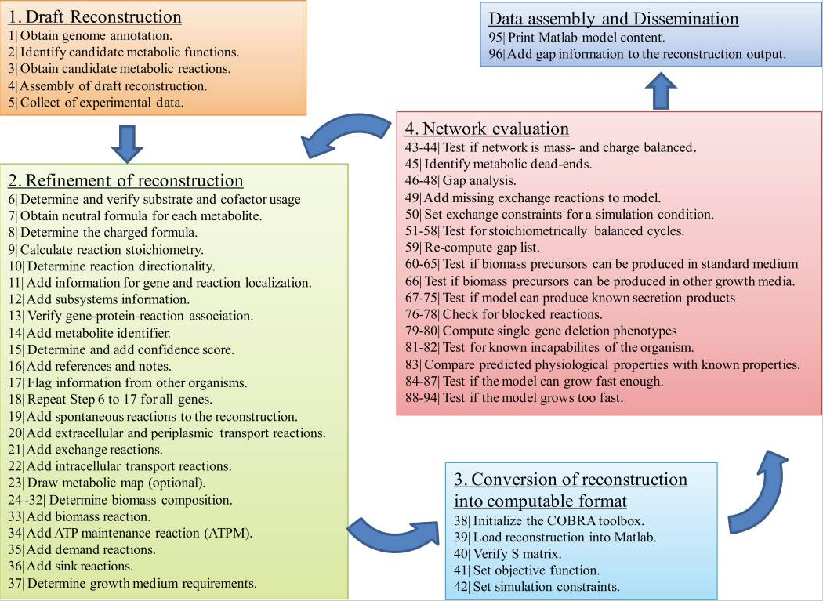
Reconstruction Workflow
96-step QC/QA’ed SOP that systematically integrates information into knowledge
Output:
A network reconstruction that is a knowledge-base Newer versions include protein synthesis and stress functions
Nat Protoc. 2010; 5(1): 93–121.

Slide 18
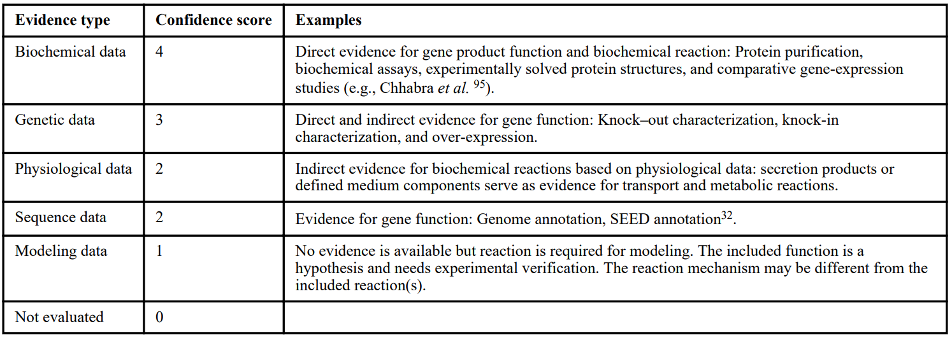
Confidence Scores track evidence for GPRs
Nat Protoc. 2010; 5(1): 93–121.

Slide 19
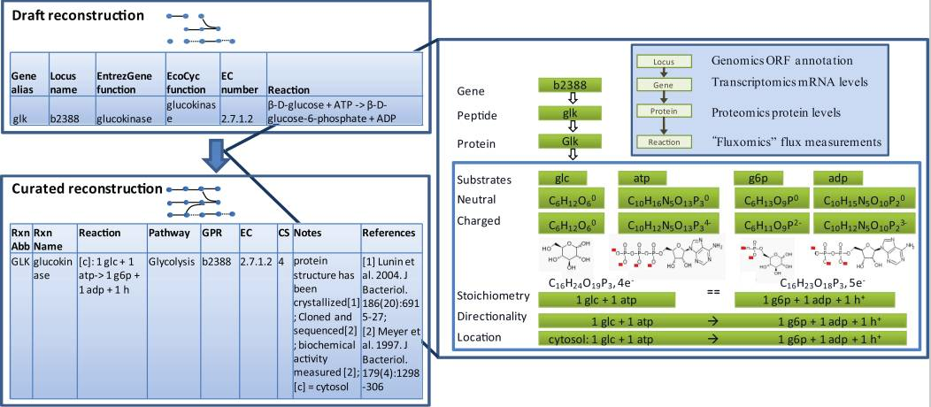
A concrete example
Nat Protoc. 2010; 5(1): 93–121.

Slide 20
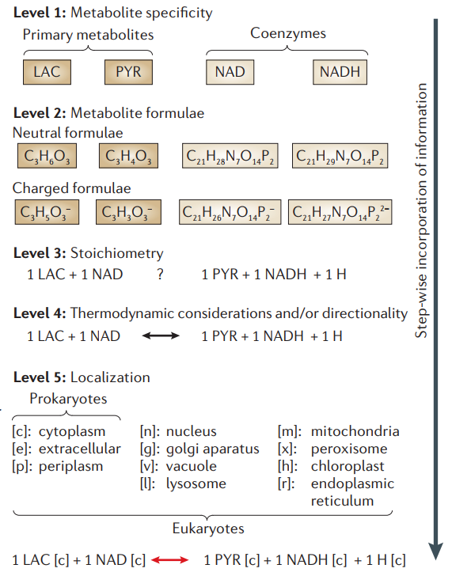
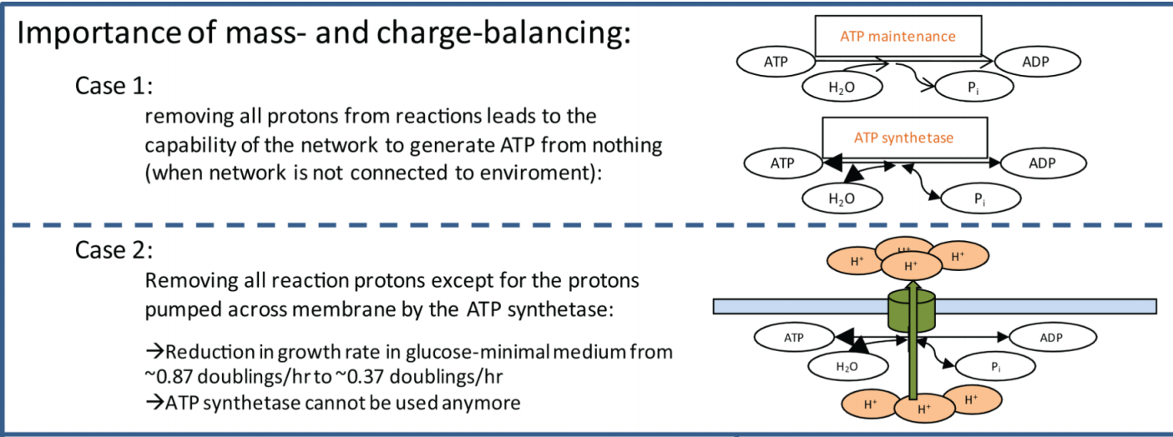
Mass and Charge Balancing
(For H+ balancing - most common)
Identify physiological charge using pK_{a} of compounds
Balance reactions most likely with H+
Nat Protoc. 2010; 5(1): 93–121.
Nature Reviews Genetics 7, 130–141 (2006)

Slide 21
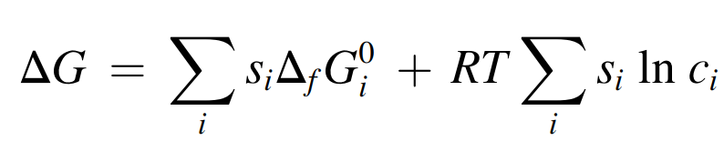
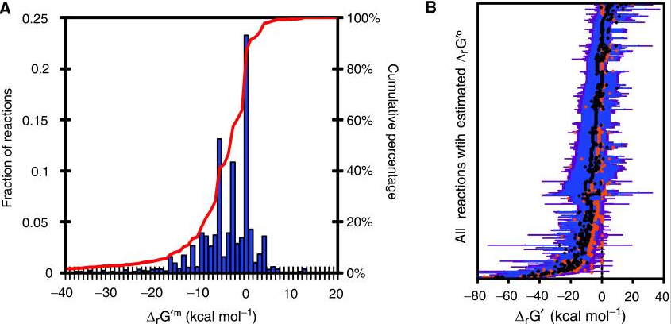
Determining reaction reversibility
Reversibility determines default flux constraints
Rev: v_{lb} = -inf, v_{ub} = inf
Irrev: v_{lb} = 0, v_{ub} = inf
Reaction is irreversible if it can never proceed in reverse physiologically
Reversible otherwise
Reversibility depends on two things
Reaction K_{eq}
Metabolic concentrations
Literature and computational evidence can be used
Mol Syst Biol. 2007; 3: 121.

Slide 22
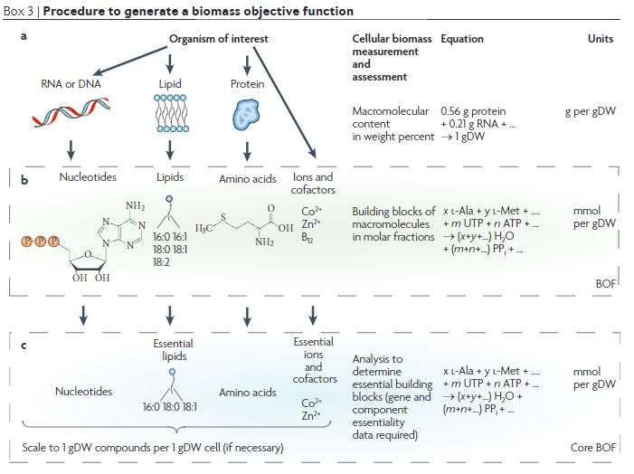
Modeling Growth: The biomass reaction v_{biomass}
Nat Rev Microbiol. 2009 Feb;7(2):129-43.

Slide 23
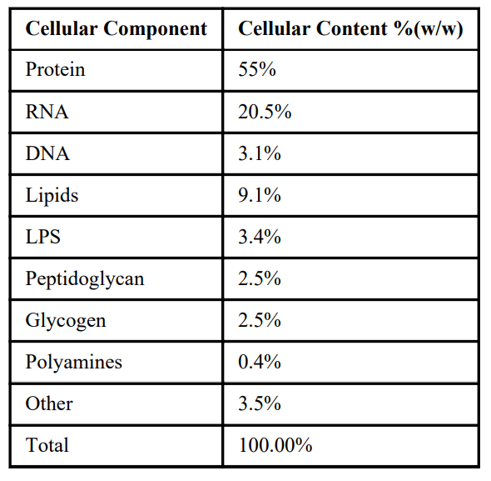
Typical cell composition (E. coli)
Rule of Thumb (not 100% true)
Component fractions are cell-type and condition specific
Within ~20% variation
Precursor fractions relatively fixed
AA fractions ~constant across growth conditions
NTP fractions defined by genome
Nat Protoc. 2010; 5(1): 93–121.

Slide 24
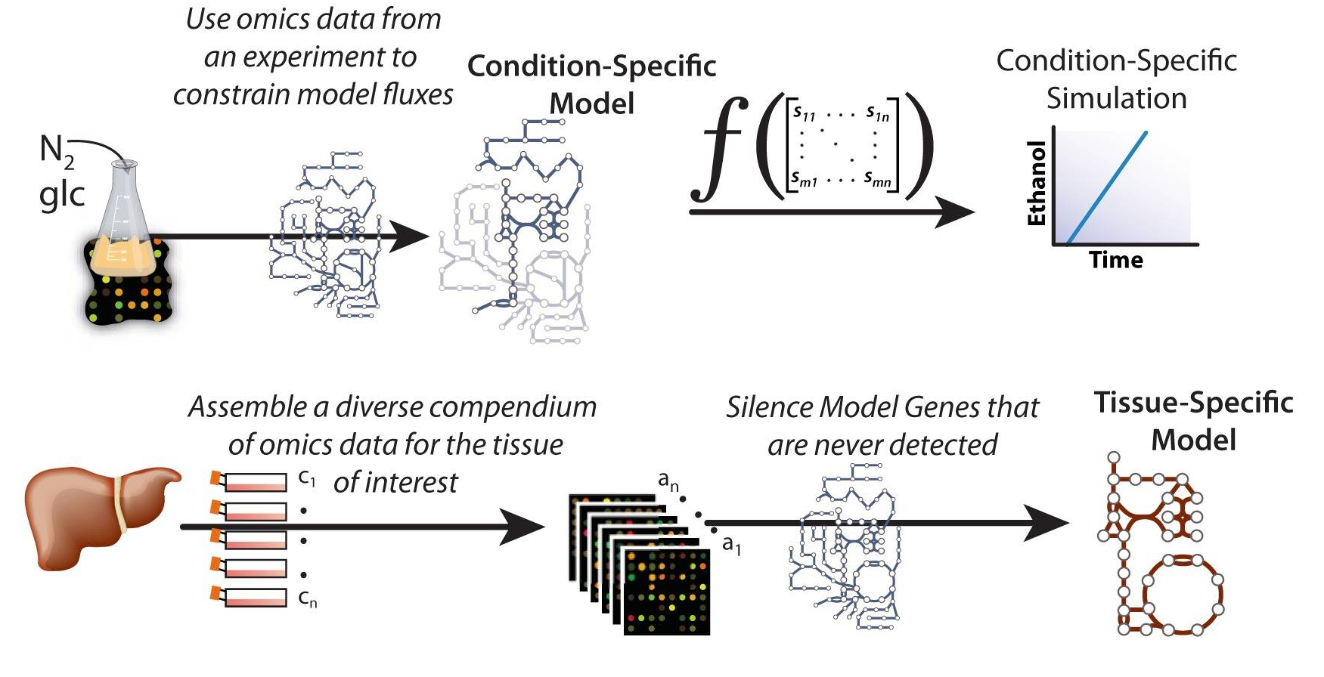
Condition-specific networks
https://www.ncbi.nlm.nih.gov/pmc/articles/PMC3594511/

Slide 25
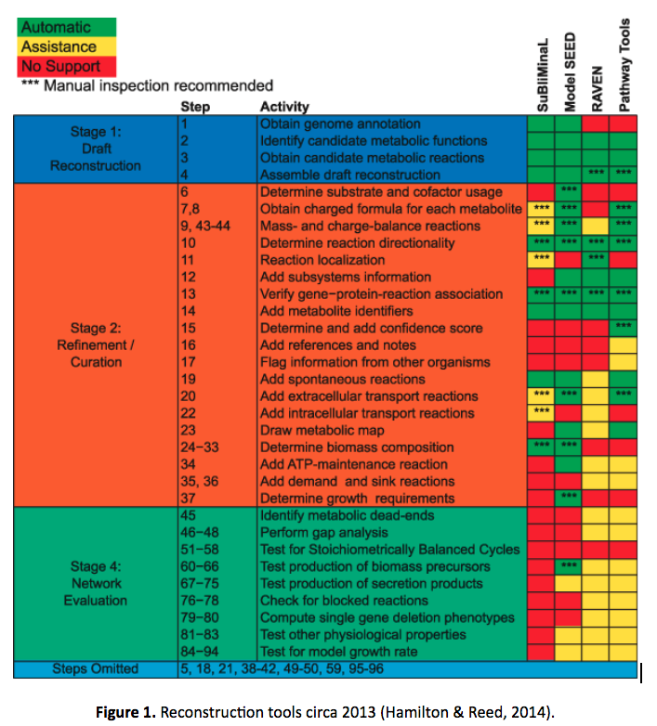
Reconstruction Tools
Large number of tools available
RAVEN, rBioNet, SEED, Simpheny, SuBliMinal, many more
Various languages and platforms
Different parts of the 96 step workflow are handled
No consensus on best tools

Slide 26
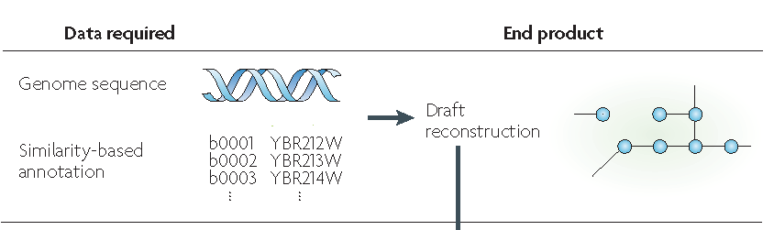
Using reconstructions to understand phylogeny
Knowledge-bases as scaffolds for data analysis

Slide 27
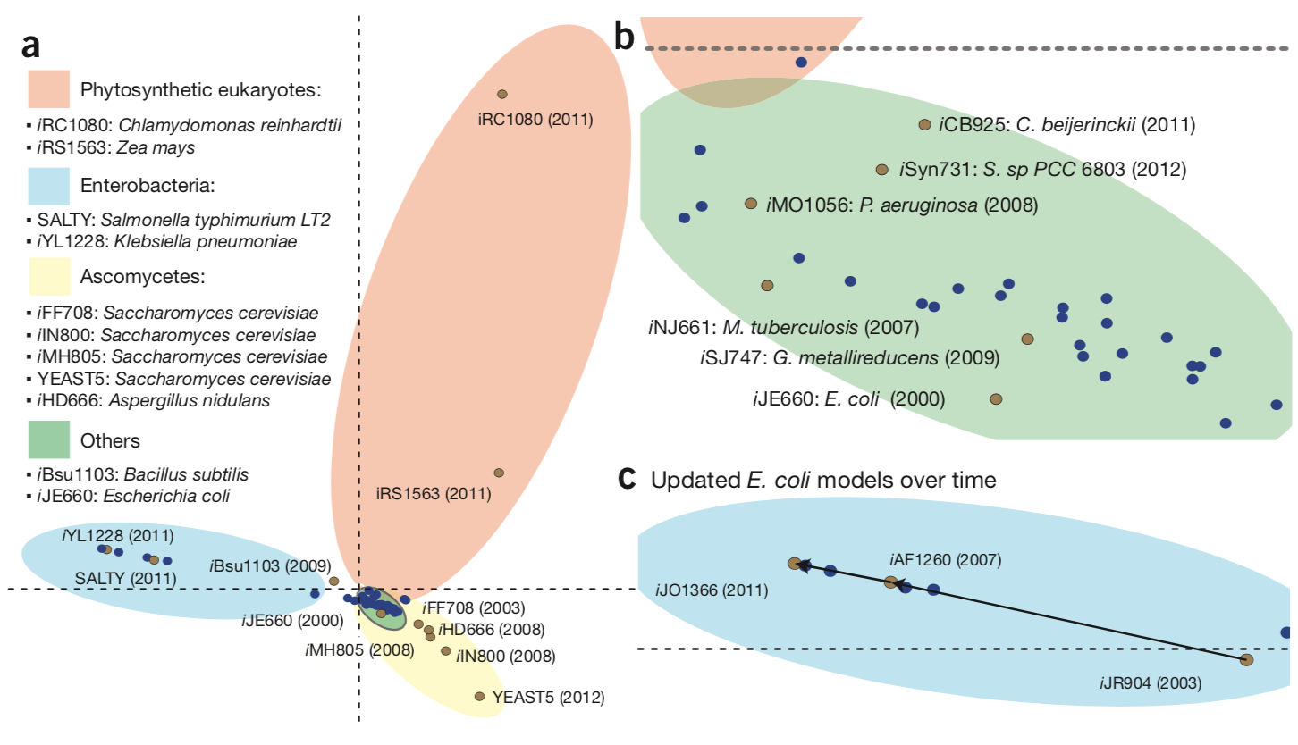
Clustering of GENREs using multiple correspondence analysis (MCA)
GENREs cluster in four groups
Enterobacteria, yeasts and photosynthetic eukaryotes show distinct reactomes
Iterations of E. coli GENREs show increasing organism-specific metabolic content
Over-representation of primary metabolism in GENREs relative to secondary metabolism cause metabolically diverse organisms to fall in same cluster (green area)
Monk et al, 2014

Slide 28
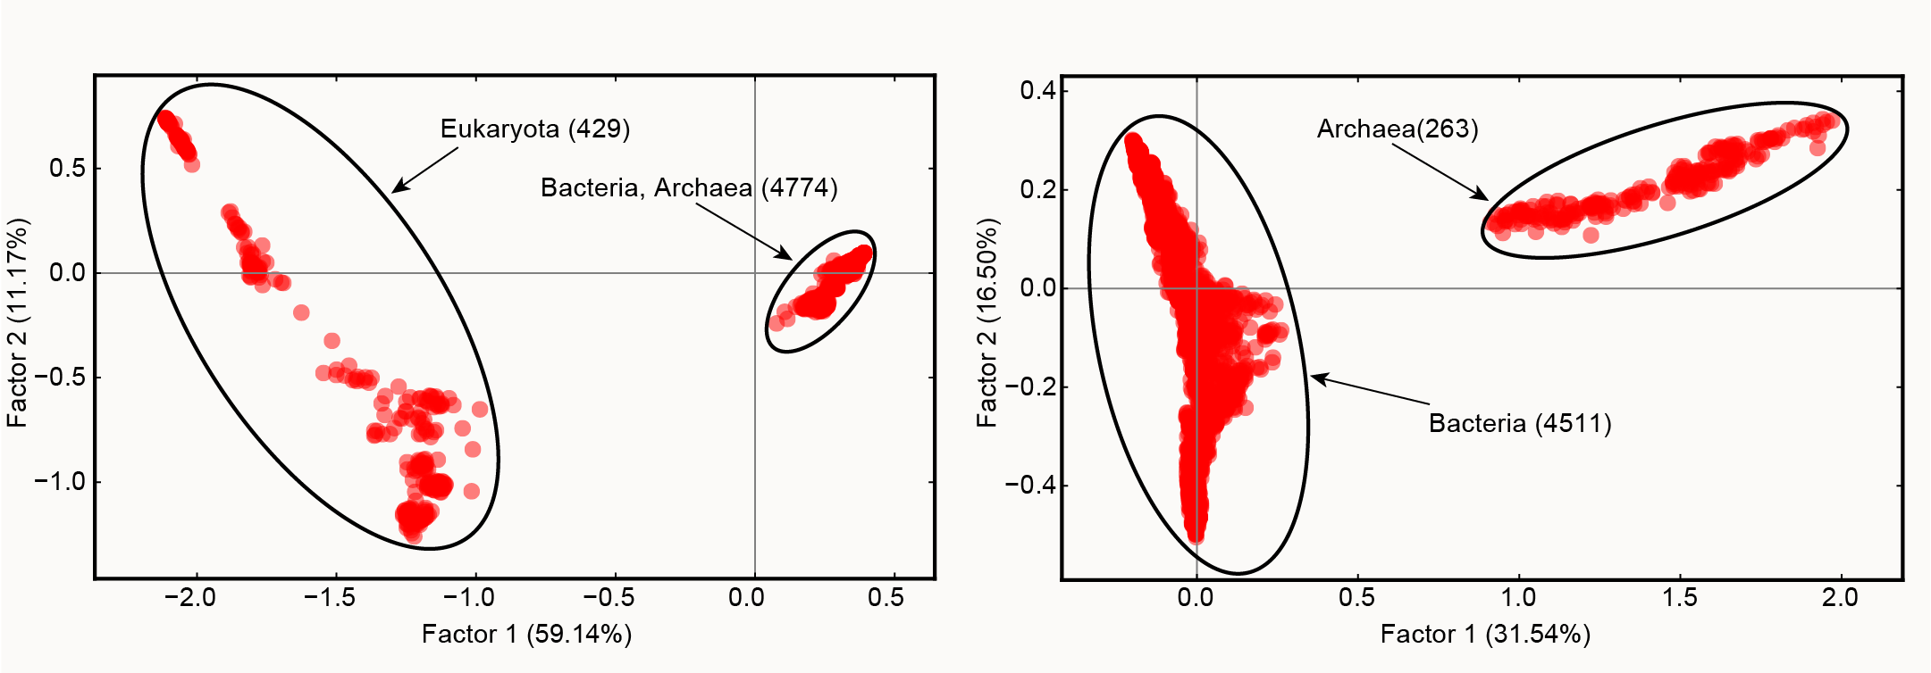
Broad phylogenetic assessment:
Clustering of KEGG organism reactome
MCA on the reactome of 8247 reactions from 5203 organisms on KEGG
Factor 1 separates eukaryotes from bacteria and archaea
Top features in factor 1 are eukaryote specific: transcription and translation processes, signaling pathways, sugar metabolism, etc
MCA on bacteria and archaea only (4774 organisms with 4967 reactions)
Factor 1 separates bacteria and archaea
Top features in factor 1 are archaea specific: transcription and translation processes, metabolic processes including diphthine synthase, FAD synthetase, glycerophospholipid metabolism, etc

Slide 29
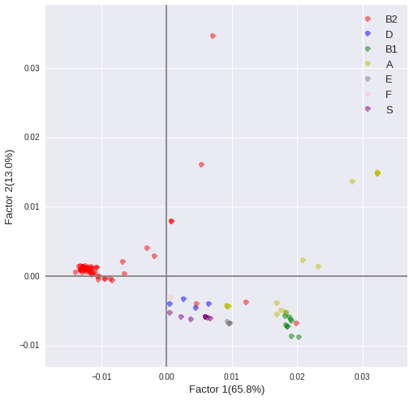
Narrow phylogenetic assessment: Clustering of E. coli strains based on pan reactome
MCA on the pan reactome of 2921 reactions reconstructed for 110 E.coli strains
Most strains in the same phylogroup cluster together (except for group A)
Factor 1 separates most B2 strains from strains in other phylogroups
Reactions with highest loadings in factor 1 involved in aromatic AA breakdown, alternative carbon metabolism, transport reactions and nitrogen metabolism

Slide 30
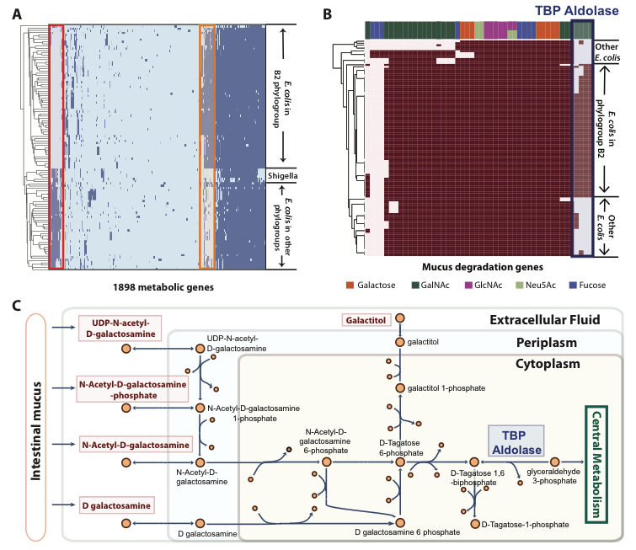
Tagatose metabolism

Slide 31
Using metabolic pathways to analyze data
Reconstruction-based pathway definitions?

Slide 32
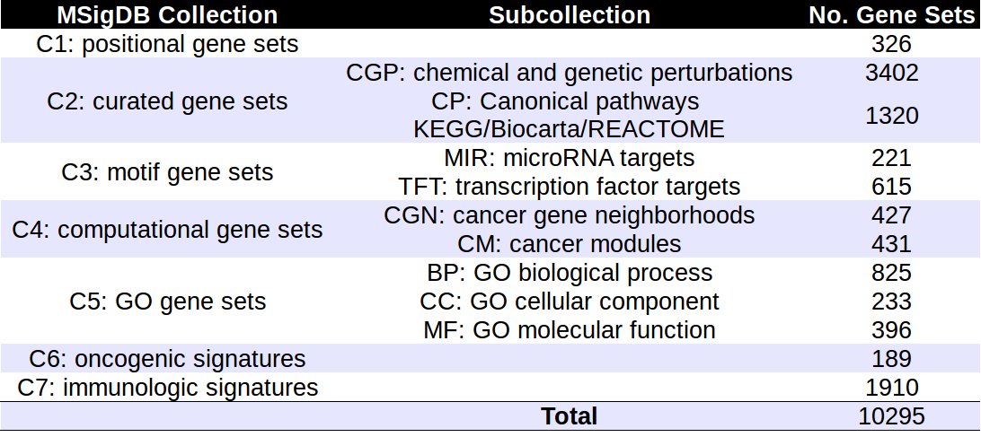
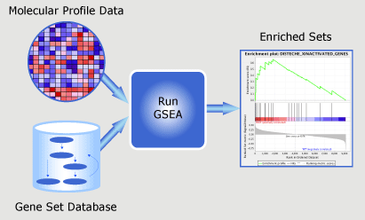
Canonical Pathway Databases
Gene Set Enrichment Analysis (GSEA) on MSigDB
Statistically assess differential expression in pre-defined gene sets
Definition of gene sets are manual
http://genomespot.blogspot.com/2015/03/are-we-ready-to-move-beyond-msigdb-and.html
http://software.broadinstitute.org/gsea/index.jsp

Slide 33
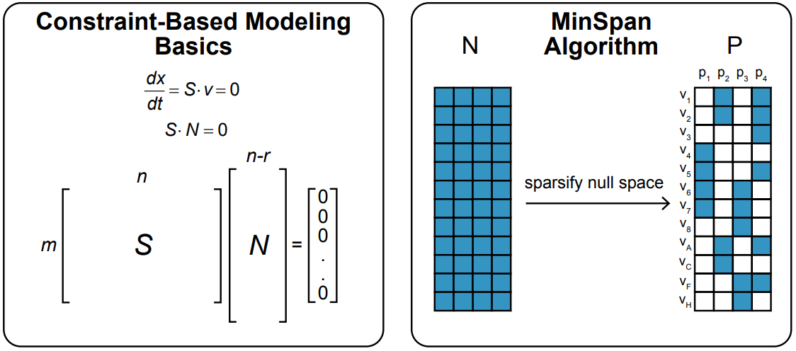
Model-defined Pathways: MinSpan
https://www.ncbi.nlm.nih.gov/pmc/articles/PMC4299494/

Slide 34
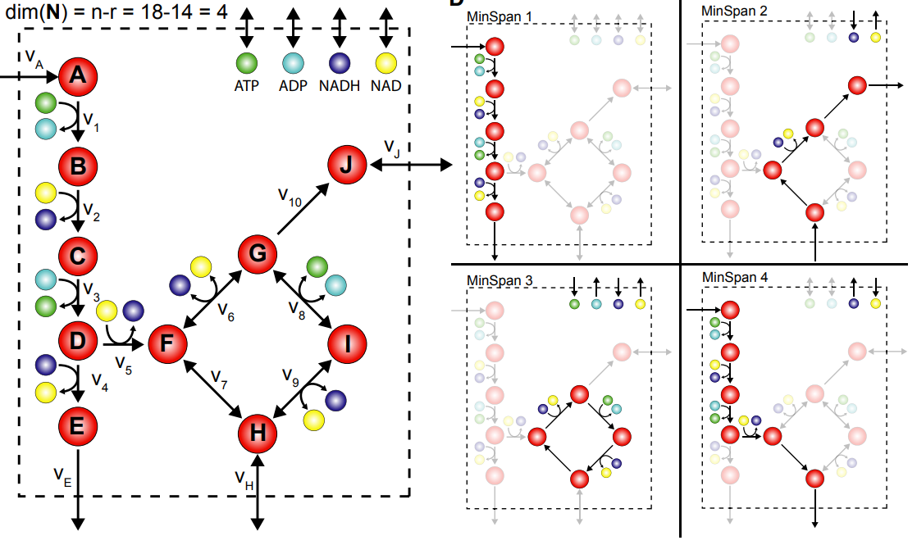
MinSpans define metabolic functions
https://www.ncbi.nlm.nih.gov/pmc/articles/PMC4299494/

Slide 35
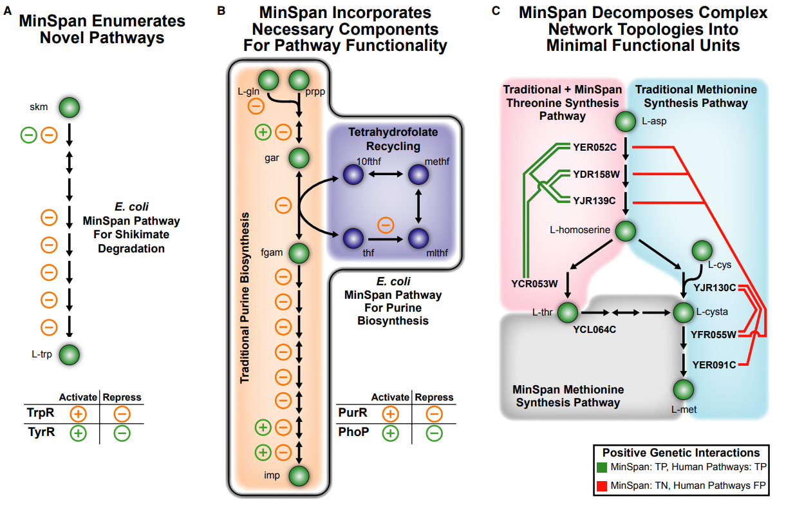
Network based pathway definitions
https://www.ncbi.nlm.nih.gov/pmc/articles/PMC4299494/

Slide 36
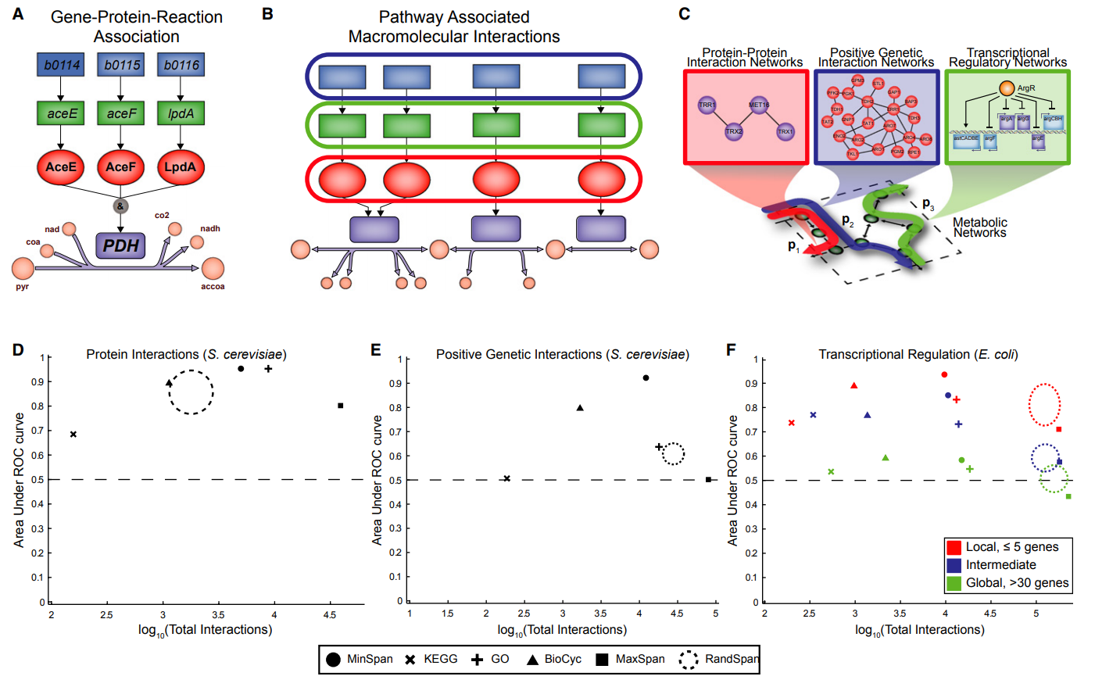
Analysis of biomolecular data
https://www.ncbi.nlm.nih.gov/pmc/articles/PMC4299494/

Slide 37
Summary
Reconstructions are structured knowledge bases
Reconstruction itself contains data types (i.e. the reactome) that reveal organism-specific metabolic differences
Protein structures are now available at genome-scale, enabling new analyses
Gene and protein expression data can be mapped onto reconstructions to generate condition- and tissue-specific networks
Pathways provide a network context to understand and predict coordination of changes in biological variables

Slide 38
Exercise 1: Escher and COBRApy

Slide 39

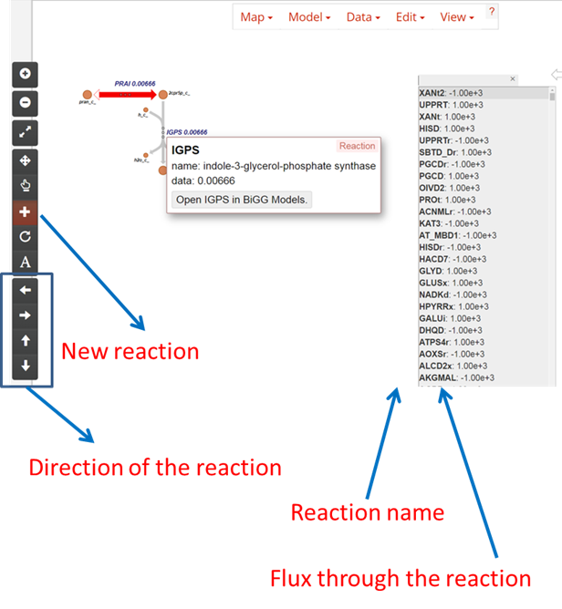
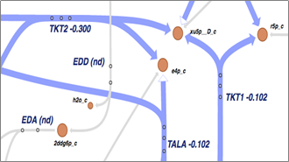
Task 1: Visualizing metabolic networks
Escher is a web-based metabolic network viewer
https://escher.github.io/
Choose an organism, map and “Builder” options
Click “Load Map” (opens new tab)
Explore metabolite and reaction tooltips
Navigate to BiGG database from a reaction or metabolite
Add a new reaction to the map extending from an existing metabolite
Organize your new reaction spatially
Explore the docs
https://escher.readthedocs.io/en/stable/getting_started.html

Slide 40
Task 2: Exploring Reconstructions with COBRApy
COBRApy is a Python-based software package for constraint-based metabolic modeling
Go to the Module 1 exercise in the Short Course Github repository and begin open the iPython notebook “FBA Introduction.ipynb”
https://github.com/SBRG/GDGA_Shortcourse
Explore and execute the notebook

Slide 41
Module 1: Constraint-based Reconstruction and Analysis (COBRA)
Part 2: Designing production strains with constraint-based modeling

Slide 42
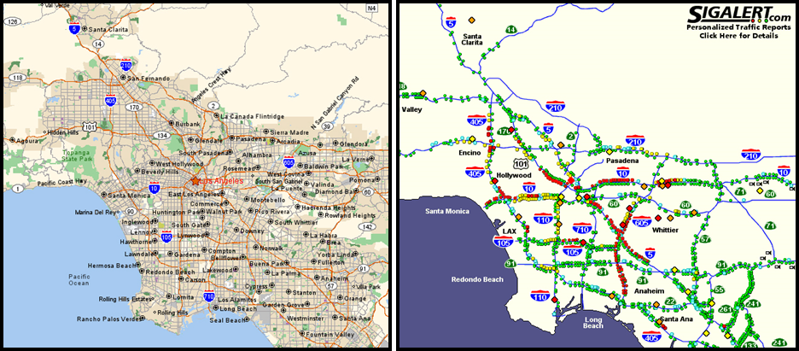
Network structure vs Network flow

Slide 43
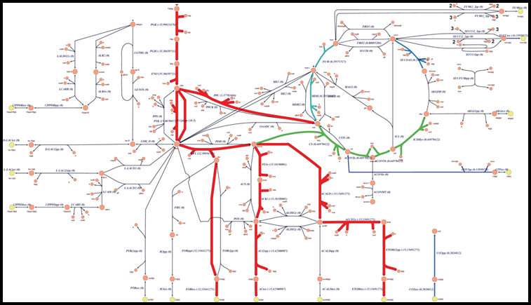
Flow through a metabolic network

Slide 44
The stoichiometric matrix

Slide 45
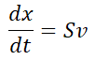
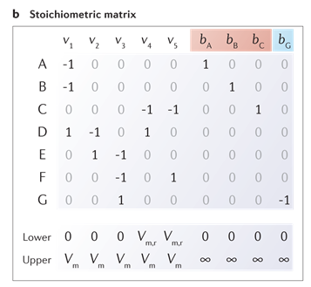
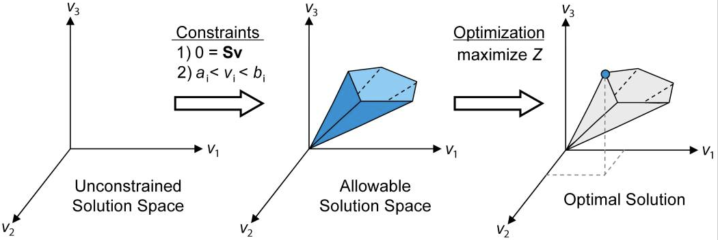
Solving mass balances at steady state with Flux Balance Analysis (FBA)
Nat Biotechnol. 2010 Mar; 28(3): 245–248.
Mass balance constraints create a linear space that can be explored with convex analysis

Slide 46
Choosing an objective ‘function’ c^{T}
Mathematically - c is a vector such that c^{T}v is optimized
e.g. if c is 1 for v_{biomass} and 0 for all other reactions, v_{biomass} will be maximized or minimized
Intuitively - c is a hypothesis about what the cell is trying to do metabolically
Growth: v_{biomass}
ATP production: ATP+H₂O -> ADP + Pi + H
NADPH production: NADPH -> NADP + H
Minimize total flux (total enzyme): Σv
None
Sampling: Find interior points
Flux Variability Analysis: Find max/min of each reaction

Slide 47
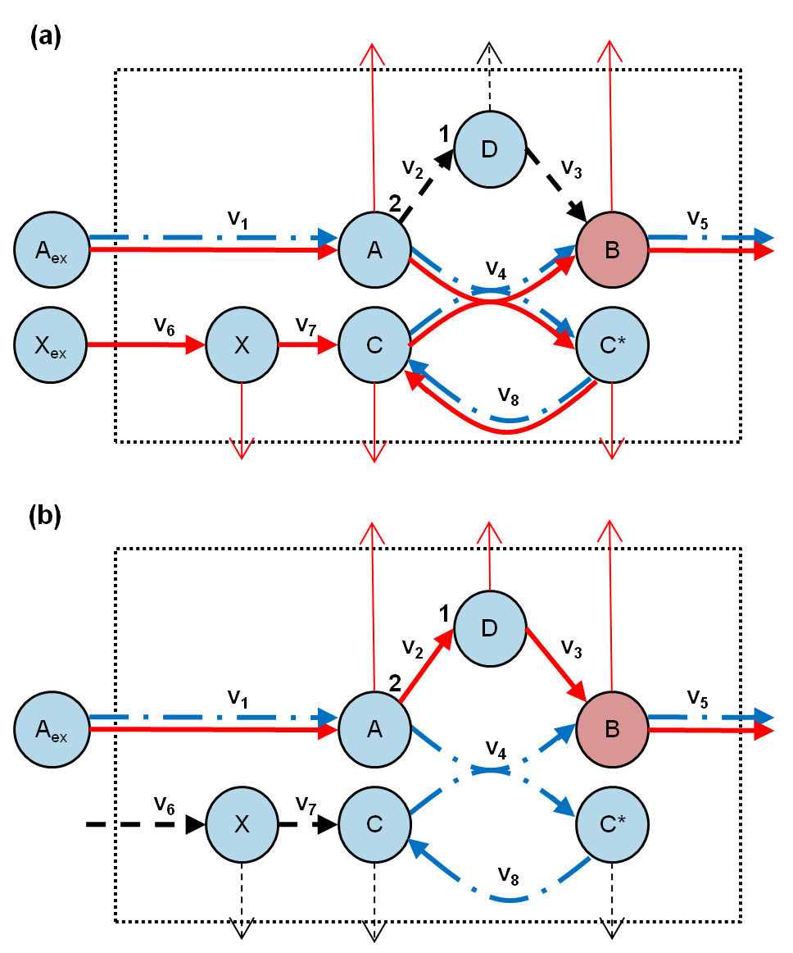
Constraints
Constraints provide resolution on v_{lb} and v_{ub}
Otherwise v_{lb} and v_{ub} are {-inf, 0, or inf} according to reversibility
Exchange reactions
Data source: Metabolite uptake/secretion rates
v_{biomass}
Data source: Growth rate measurements
ATP maintenance costs (v_{ATPM})
Data source: Uniform value across many conditions
Internal constraints
Data source: 13C measurements
Genome Biology 2010 11:R43

Slide 48
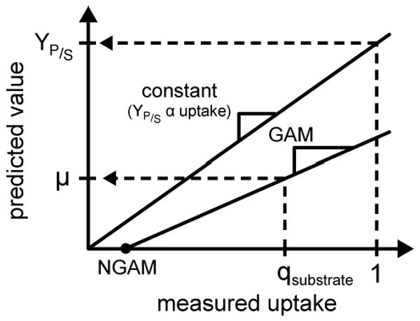
ATP maintenance costs
ATP is consumed by non-metabolic processes
GAM: Growth-associated maintenance
e.g. translation, transcription costs
NGAM: Non-growth associated maintenance
e.g. active transport maintaining ion gradients
Curr Opin Microbiol. 2010 Jun; 13(3): 344–349.

Slide 49
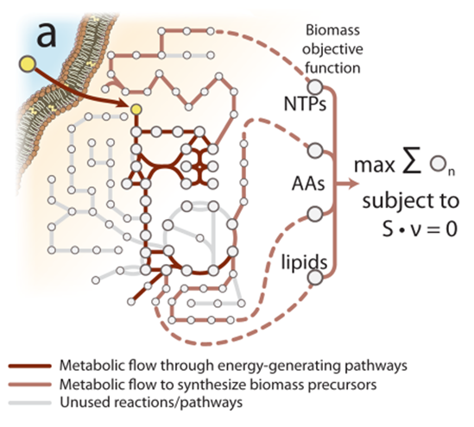
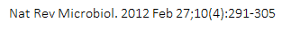
Example: Modeling growth with v_{biomass}

Slide 50
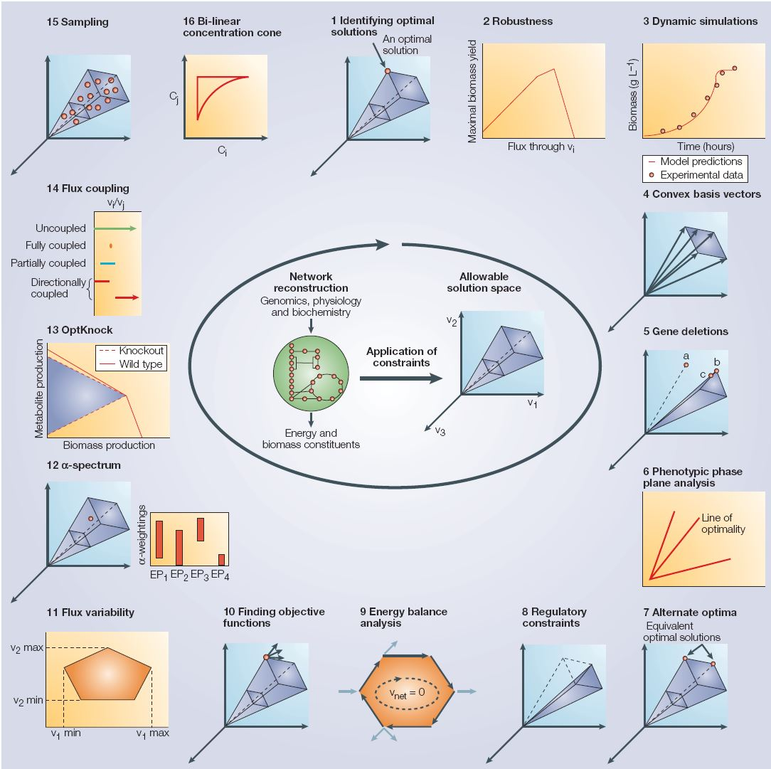
Exploring the Space of Steady-State
Reaction Fluxes
Nat Rev Microbiol. 2004 Nov;2(11):886-97.

Slide 51
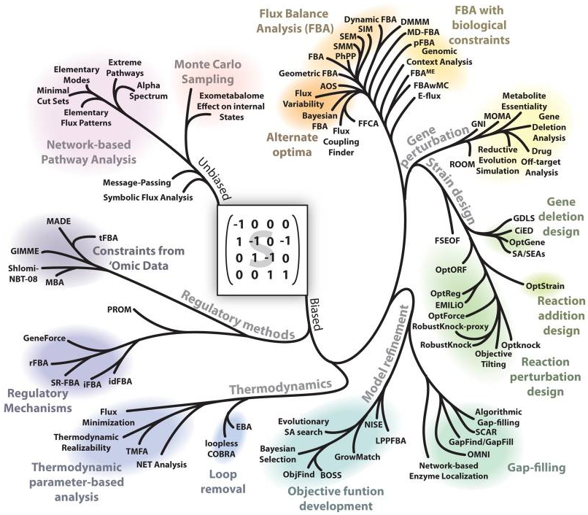
Constraint-based Modeling Algorithms
Key categories
Flux Balance Analysis
Model Refinement
Gap-filling
Objective function development
Constraints from ‘Omic Data
Nat Rev Microbiol. 2012 Feb 27; 10(4): 291–305.

Slide 52
Predicting growth using metabolic modeling
Can data be integrated mechanistically into constraint-based models?

Slide 53


E. coli evolves to growth-optimal phenotypes
https://www.ncbi.nlm.nih.gov/pubmed/12432395

Slide 54



Classification of differential growth properties
http://www.pnas.org/content/110/50/20338

Slide 55

Prediction of sKO/dKO
http://science.sciencemag.org/content/344/6191/1448/tab-pdf

Slide 56


Applied uses of metabolic reconstructions
J Intern Med. 2012 Feb; 271(2): 131–141.

Slide 57

Growth coupled production designs
Normally, growth competes with production of a target compound
However, through knockouts, flux can be rerouted so that production of target is required for growth (Growth coupled)
Growth coupling can be weak, holistic, or strong (see below), depending on how production changes with growth rate
Blue: Space of ‘allowed’ flux states
https://bmcbioinformatics.biomedcentral.com/articles/10.1186/s12859-019-2946-7

Slide 58



Example Design: OptKnock
https://onlinelibrary.wiley.com/doi/epdf/10.1002/bit.10803

Slide 59


Using growth coupling for enzyme selection systems
Only poor growth-coupling of Mtase under glucose-limited conditions
Cysteine demand of biomass production is low
Strong growth-coupling sets in only when glucose uptake constraint (10 mmol/gDW/h) is reached
Methionine becomes an (additional) carbon source
Extremely high oxygen demand at maximum growth rate (51 mmol/gDW/h)

Slide 60





Growth-Coupled Selection Systems
Enzyme/function of interest
Basic coupling element
(carbon, nitrogen)
Gene knockouts
Heterologous reaction addition
Substrates
metabolism
growth
Gene knockouts
Medium composition
Heterologous reactions
Whole cell evolution (ALE)
Selection systems for pathways/functions
Selection systems for enzymes
Improve intracellular precursor supply
Improve target compound production
Find favourable structural mutations
Improve regulation in favor of enzyme activity and expression
Determine and reverse-engineer mutations

Slide 61
Part 2 Summary
Metabolic network reconstructions can be converted into constraint-based models by 1) constructing the stoichiometric matrix, and 2) defining constraints and an optimization objective
Metabolic models enable prediction of growth rate opening a myriad opportunities (sKO/dKO, etc)
A variety of constraint-based algorithms have been developed to explore the constraint space and improve model predictions
Growth-coupled designs produce more compound at higher growth rate, enabling growth-based selection of production strains
Metabolic models can predict growth-coupled designs with specialized algorithms that explore possible gene knockouts/knockins

Slide 62
Exercise 2: Growth-coupled designs
Navigate back to the Github repository “Module1_FBA” and enter the “Part2_ Exercise notebook/Growth Coupling Workflows”
Explore and execute the two iPython notebooks
01_GrowthCouplingAlgorithm_14Butanediol_Basics.ipynb
02_GrowthCouplingAlgorithm_14Butanediol_Advanced.ipynb

Slide 63
End of Module 1

